Slide 1
CPSO using Spatially Meaningful Neighbors
PSO
Notes:
Good Morning everyone.
I’m here to talk a bit about the Project I am doing for my 3F90 with Professor Ombuki.
The topic of the project is ‘CPSO using Spatially Meaningful Neighbors’. I’ll try to cover what that means by breaking it down into it’s parts and I’ll try to discuss why we feel it is a worthwhile field of study, starting with the base, PSO.

Slide 2
PSO
Notes:
So I’m going to assume knowledge on the base PSO algorithm so I’m only going to briefly cover it here since it is important to the greater knowledge of the topic.
PSO is a computational intelligence algorithm that is used to help optimize continuous problems. If is modelled after the flocking patterns of birds and more specifically, the way they work as a team to search out food, nesting locations and more.

Slide 3
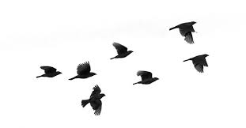
Follow The Leader
Leader
Notes:
Birds typically use a ‘Follow the Leader’ approach and that is represented in the PSO algorithm. The bird that currently sees the best landing spot will guide it’s flock to the location unless a better one is found along the way, in which the flock then changes leaders.

Slide 4
PSO
Global Best
Particle
Solutions
Notes:
In the vanilla PSO algorithm, this behavior is replicated almost verbatim.
The particles are the birds and they move towards the global best. One thing you’ll notice with this arrangement, however, is you have an entire swarm of particles, but the only actual communication is a one way communication from leader to each particle.
This can lead to some naiive behaviour that can result into premature convergence without adequate traversal of the entire search space.

Slide 5

Neighbor Cooperation
Notes:
To combat this, research has been performed on a number of different techniques to allow particles to share information. The connections, called Neighborhood Topologies, are different configurations that dictate which particle can talk to which in an attempt to maximize the effectiveness of this communication.

Slide 6
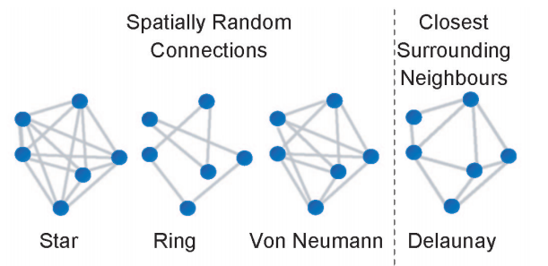
Neighborhood Topologies
Notes:
Connected particles are free to share information, but only connected particles.
Here are a number of popular configurations that have been tested if differing results.
The star topology connects all particles together, ring randomly connects particles in a chain (i.e. only 2 connections per particle) and von neumann allows for 4 per particle.

Slide 7
PSO Using Spatially Meaningful Neighbors
Particle Swarm Optimization with Spatially Meaningful Neighbours
James Lane, Andries Engelbrecht and James Gain
Notes:
In the paper “Particle Swarm Optimization with Spatially Meaningful Neighbours” by Lane, Engelbrecht and Gain. They came up with a new neighborhood configuration. The used the distance of the neighbors to only connect particles to at most 4 of it’s closest neighbours.
The idea behind this configuration is that hypothetically, the particles close together are searching the same subspace and therefore their values may be more important in determining the next movement than the global best.

Slide 8
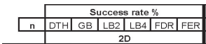
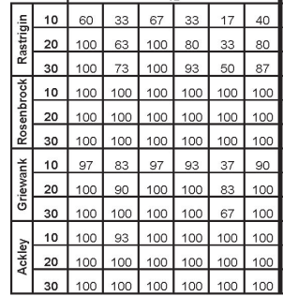
Results
Notes:
In their tests, this led to higher success rates. However, there is a problem with this method.

Slide 9
Problem
Delaunay Triangulation in 2D
O(nlogn)
Delaunay Triangulation in 4D+
O(n^{[d/2]+1})
Notes:
To calculate the distance of the particles, the quickest and easiest way is to use an algorithm to generate the Delaunay Triangulation of those points. In 2 and 3 dimensions this is trivial, however it becomes increasingly difficult in higher dimensions.

Slide 10
PSO
Global Best
Particle
Solutions
Notes:
If we return to this graph, this PSO is optimizing to variables (x and y) and is therefore, a 2 dimensional problem. Increasing the number a variables in the problems increases the dimensionality of the problem. But as we can see, this increase of dimensionality doesn’t just effect the difficulty to calculate the Delaunay Triangulation, it also increases the difficulty of the PSO itself.
As the dimensions increase, so does the size of the search space (exponentially so). Thankfully, some research has been conducted to solve this problem for PSO that we can also take advantage of to solve our problem with Delaunay Triangulation.

Slide 11
Solution
CPSO
A Cooperative Approach to Particle Swarm Optimization
Bergh and Engelbrecht
Notes:
This solution is known as CPSO (or Cooperative PSO). How it combats dimensionality is instead by dividing the high dimension problems into a number of smaller problems and optimizing them separately. It then merges the results at the end and returns that solution.

Slide 12

CPSO using spatially significant Neighbors
Notes:
By combining the power of Cooperative Particle Swarm Optimization with the success of spatially meaningful neighbors, we are able to divide high dimension problems into a number of 2 or 3 dimension problems to better make use of the benefits that the Spatially meaningful neighbors communication brings.
This will allow us to expand this finding to a larger number of problems and ultimately make the new topology more useful.

Slide 13
CPSO Variants
CPSO-S
CPSO-S_{k}
CPSO-R_{k}
CPSO-H_{k}
Notes:
There are a number of CPSO variants that will be tested.
CPSO-S simply divides each dimension into multiple 1 dimensional PSOs
CPSO-Sk evenly divides the problem into k smaller problems
CPSO-Rk randomly divides the problem into k smaller problems
And CPSO-Hk (also known as Hybrid CPSO) simultaneously runs a standard PSO and swaps information between that and the CPSO

Slide 14
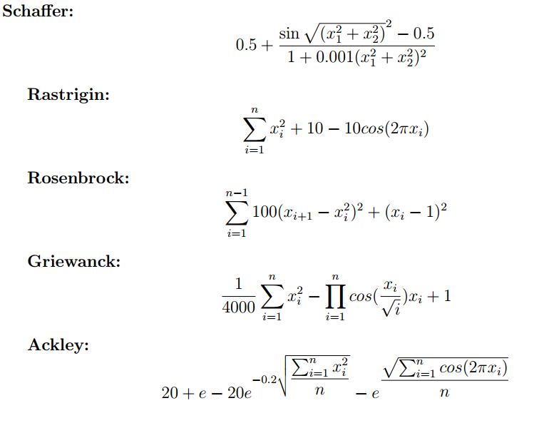
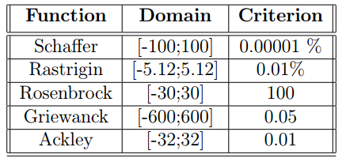
Tests
Notes:
Consistent with the CPSO papers, I will run the CPSO variants against the following optimization functions. I will test both with and without the neighbor topology, testing the success rate and the number of iterations required to reach the criterion. This will help me determine if the use of spatially significant neighbors provide a significant enough boost to the CPSO algorithms to warrant the continued use with these algorithms.

